Slide 1
DETECTION OF BREAST CANCER USING MACHINE LEARNING
Guide:Dr Deepa Parasar
Abhay Tiwari
Mahindra Reddy
Bharat Nair

Slide 2

CONTENT
INTRODUCTION
PROBLEM STATEMENT
ALGORITHM
PROBLEM SOLUTION
CONCLUSION

Slide 3
INTRODUCTION
Machine Learning(ML) is a field of artificial intelligence that uses statistical techniques to give computer systems the ability to “learn”(e.g., progressively improve performance on a specific task) from data, without being being explicitly programmed.
Self thinking computer
AI
ML
Provides Mathematical tool to AI

Slide 4
PROBLEM STATEMENT
Breast cancer accounts for 14% of cancers in Indian women.
It is reported that with every four minutes, an Indian woman is diagnosed with breast cancer.
Breast cancer is on the rise, both in rural and urban India.
A 2018 report of Breast Cancer statistics recorded 1,62,468 new registered cases and 87,090 reported deaths.
Women can self-diagnose their condition and know of the presence of lumps or masses that suggest cancerous outgrowths.
The very reason for a low breast cancer survival rate of women in India accounts from its lack of awareness and poor early screening and diagnosis rates

Slide 5
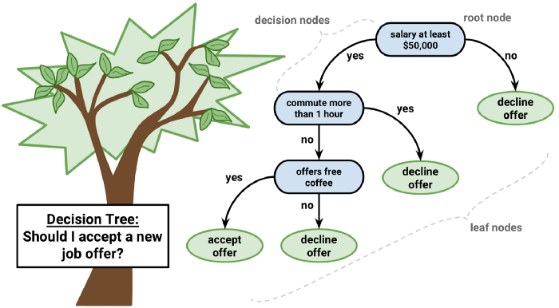
DECISION TREE

Slide 6


Random Forest Classifier
Random Forest is a popular machine learning algorithm that belongs to the supervised learning technique.
Random Forest is a classifier that contains a number of decision trees on various subsets of the given dataset and takes the average to improve the predictive accuracy of that dataset

Slide 7
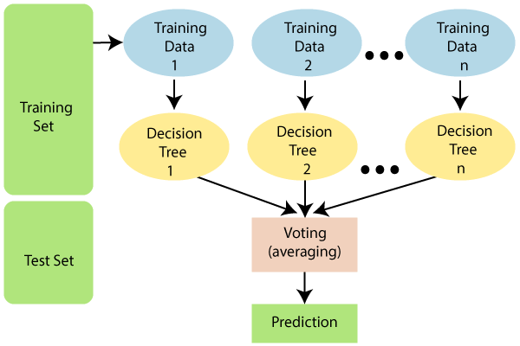
FLOW CHART

Slide 8
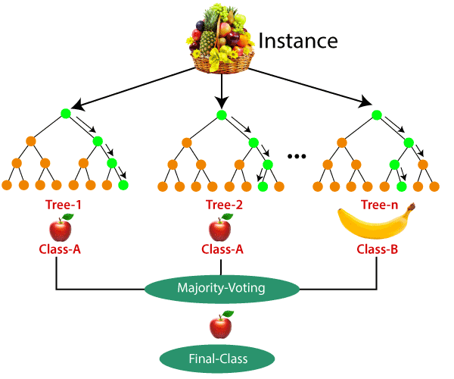
EXAMPLE

Slide 9
PROBLEM SOLUTION
Features are computed from a digitized image of a fine needle aspirate (FNA) of a breast mass. They describe characteristics of the cell nuclei present in the image.
The data from the test is then used to train a Machine Learning Model.

Slide 10
CONCLUSION
Early stage detection not only leads to less treatment but also improves the chances of survival from breast cancer.

Slide 11
REFERENCE
https://www.hindawi.com/journals/jhe/2019/4253641/
https://www.ijert.org/research/breast-cancer-classification-and-prediction-using-machine-learning-IJERTV9IS020280.pdf

Slide 12

THANK YOU

